Slide 1
CS 4530 & CS 5500
Software Engineering
Lecture 10.4: Continuous Delivery
Jonathan Bell, John Boyland, Mitch Wand
Khoury College of Computer Sciences © 2021, released under CC BY-SA

Slide 2
Learning Objectives for this Lesson
By the end of this lesson, you should be able to…
Describe how continuous delivery helps to catch errors sooner in a product’s lifecycle
Describe the distinction between a DevOps and “traditional” developer/operator mentality
Describe strategies for performing quality-assurance on software as and after it is delivered

Slide 3
Cost to Fix a Defect Over Time
Rough estimate
Today: How do we catch defects just at the inflection point of this curve?
Notes:
Review: Why expensive as move to the right?
Need to be triaged by someone who doesn’t know (or doesn’t remember)
Might now need more work, since code has changed around the bug
Has a greater impact - who wants to read about their bug on the front page of the newspaper?
So far: edit-compile-debug loop of local development, continuous integration.
Now consider:
Bug reports by internal users who are opted in to a feature before external users
Bug or outage reports by external users
Can we develop a process to detect these defects and resolve them before they have a greater impact?

Slide 4


Deploying New Code
The best that we can hope for?
“If stuff blows up it affects a very small percentage of people”
Instagram cofounder and CTO Mike Krieger
https://www.fastcompany.com/3047642/do-the-simple-thing-first-the-engineering-behind-instagram

Slide 5
Continuous Delivery
“Faster is safer”: Key values of continuous delivery
Release frequently, in small batches
Maintain key performance indicators to evaluate the impact of updates
Phase roll-outs
Evaluate business impact of new features
Notes:
Thanks to the automated software integration pipeline that we’ve built, we can now work on closing the last feedback loop: by delivering our updates frequently, we can observe the impact of each update in relative isolation. We can be agile - releasing frequently, in small batches of updates. Thanks to automation from our CI + infrastructure system, we should be able to release with relatively low human overhead. We can maintain performance indicators like crashes, or latency and work on improving them. We can roll-out these changes to just a few users before shipping to everyone, and use this data to help determine if we should do that roll-out or not. We can even use this approach to evaluate whether newly designed features are used by users as our product designers intended - for instance, if we are implementing improvements to the usability of a commenting system, we might measure whether there are more comments made using the new feature or not. There are a few tricks that we can use to make this all work (and not make our software worse).

Slide 6
Staging Environments
Enabling Continuous Delivery
As software gets more complex with more dependencies, it's impossible to simulate the whole thing when testing
Idea: Deploy to a complete production-like environment, but don't have everyone use it
Examples:
“Eat your own dogfood”
Beta/Alpha testers
Lower risk if a problem occurs in staging than in production
Notes:
A key pre-requisite for continuous delivery is a staging environment . As software becomes more complex,

Slide 7

Test-Stage-Production
Continuous Delivery in Action
Developer Environments
Beta/Dogfooding
User Requests
Testing Environment
Staging Environment
Production Environment
Revisions are “promoted” towards production
Q/A takes place in each stage (including production!)

Slide 8
Operations Responsibility
DevOps in a slide
Once we deploy, someone has to monitor software, make sure it’s running OK, no bugs, etc
Assume 3 environments:
Test, Staging, Production
Whose job is it?
 | Developers | Operators
Waterfall
Agile
DevOps
Test
Staging
Production
Test
Staging
Production
Production
Production
Test
Staging

Slide 9
DevOps Values
One team owns changes "from cradle to grave"
You are the support person for your changes, regardless of platform
Example: Facebook mobile teams (non-DevOps)
Desktop/Web
Android
iOS
Group messages
Group messages
Engineering Teams
Group messages
Group messages
Chat
Upcoming Events
Birthdays
Photo Albums
Photo Picker
Group messages
Chat
Upcoming Events
Birthdays
Photo Albums
Photo Picker
Chat
Chat
Messages
Chat
Upcoming Events
Upcoming Events
Events
Upcoming Events
Birthdays
Birthdays
Photos
Birthdays
Photo Albums
Photo Albums
Android
Photo Albums
Photo Picker
Photo Picker
iOS
Photo Picker
Product Experts
Platform Experts

Slide 10
DevOps Values
One team owns changes "from cradle to grave"
You are the support person for your changes, regardless of platform
Example: Facebook mobile teams (DevOps)
Desktop/Web
Android
iOS
Group messages
Group messages
Group messages
Engineering Teams
Group messages
Chat
Upcoming Events
Birthdays
Photo Albums
Photo Picker
Group messages
Chat
Upcoming Events
Birthdays
Photo Albums
Photo Picker
Messages
Chat
Chat
Chat
Events
Upcoming Events
Upcoming Events
Upcoming Events
Photos
Birthdays
Birthdays
Birthdays
Android
Photo Albums
Photo Albums
Photo Albums
iOS
Photo Picker
Photo Picker
Photo Picker
Product Experts

Slide 11
Deployment Pipeline
With staging environment
Develop
Build
Test
Deploy to Staging
Monitor
Deploy to Production
Monitor

Slide 12
Release Pipelines
How quickly is my change deployed?
Even if you are deploying every day, you still have some latency
A new feature I develop today won't be released today
But, a new feature I develop today can begin the release pipeline today (minimizes risk)
Release Engineer: gatekeeper who decides when something is ready to go out, oversees the actual deployment process

Slide 13
Deployment Example: Facebook.com
Pre-2016
Developers working in their own branch
When feature is ready, push as 1 change to master branch
~1 week of development
~1 week of development
master branch
All changes that survived stabilizing
3 days
4 days
Weekly
Stabilize
Release Branch
All changes from week
that are ready for release
release branch
production
Your change doesn’t go out unless you’re there that day at that time to support it!
3x Daily
“When in doubt back out”
Notes:
https://engineering.fb.com/2017/08/31/web/rapid-release-at-massive-scale/
What was bad about this?
For many years, we pushed the Facebook front end three times a day using a simple master and release branch strategy. Engineers would request cherry-picks — changes to the code that had passed a series of automated tests — to pull from the master branch into one of the daily pushes from the release branch. In general, we saw between 500 and 700 cherry-picks per day. Once a week, we’d cut a new release branch that picked up any changes that were not cherry-picked during the week.
By 2016, we saw that the branch/cherry-pick model was reaching its limit. We were ingesting more than 1,000 diffs a day to the master branch, and the weekly push was sometimes as many as 10,000 diffs. The amount of manual effort needed to coordinate and deliver such a large release every week was not sustainable.

Slide 14
Deployment Example: Facebook.com
Chuck Rossi, Director Software Infrastructure & Release Engineering @ Facebook
“Our main goal was to make sure that the new system made people’s experience better — or at the very least, didn’t make it worse. After almost exactly a year of planning and development, over the course of three days in April 2017 we enabled 100 percent of our production web servers to run code deployed directly from master.”
“Rapid release at massive scale” https://engineering.fb.com/2017/08/31/web/rapid-release-at-massive-scale/

Slide 15
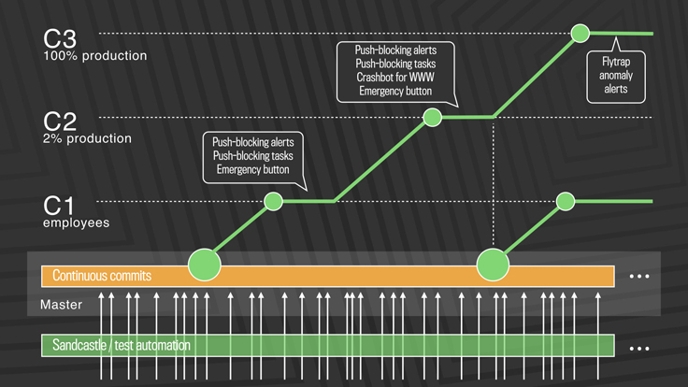
Deployment Example: Facebook.com
Post-2016: Truly continuous releases from master branch
https://engineering.fb.com/2017/08/31/web/rapid-release-at-massive-scale/
Notes:
First, diffs that have passed a series of automated internal tests and land in master are pushed out to Facebook employees. In this stage, we get push-blocking alerts if we’ve introduced a regression, and an emergency stop button lets us keep the release from going any further. If everything is OK, we push the changes to 2 percent of production, where again we collect signal and monitor alerts, especially for edge cases that our testing or employee dogfooding may not have picked up. Finally, we roll out to 100 percent of production, where our Flytrap tool aggregates user reports and alerts us to any anomalies.
Many of the changes are initially kept behind our Gatekeeper system, which allows us to roll out mobile and web code releases independently from new features, helping to lower the risk of any particular update causing a problem. If we do find a problem, we can simply switch the gatekeeper off rather than revert back to a previous version or fix forward.

Slide 16
A/B Deployments with Canaries
Mitigating risk in continuous delivery
Monitor both:
But minimize impact of problems in new version

Slide 17
Blue-Green Deployment
Always have 2 complete environments ready:
One that you’re using now
One that you’re just about ready to use
Easily switch which is handling requests

Slide 18
Monitoring
The last step in continuous deployment: track metrics
Hardware
Voltages, temperatures, fan speeds, component health
OS
Memory usage, swap usage, disk space, CPU load
Middleware
Memory, thread/db connection pools, connections, response time
Applications
Business transactions, conversion rate, status of 3rd party components

Slide 19
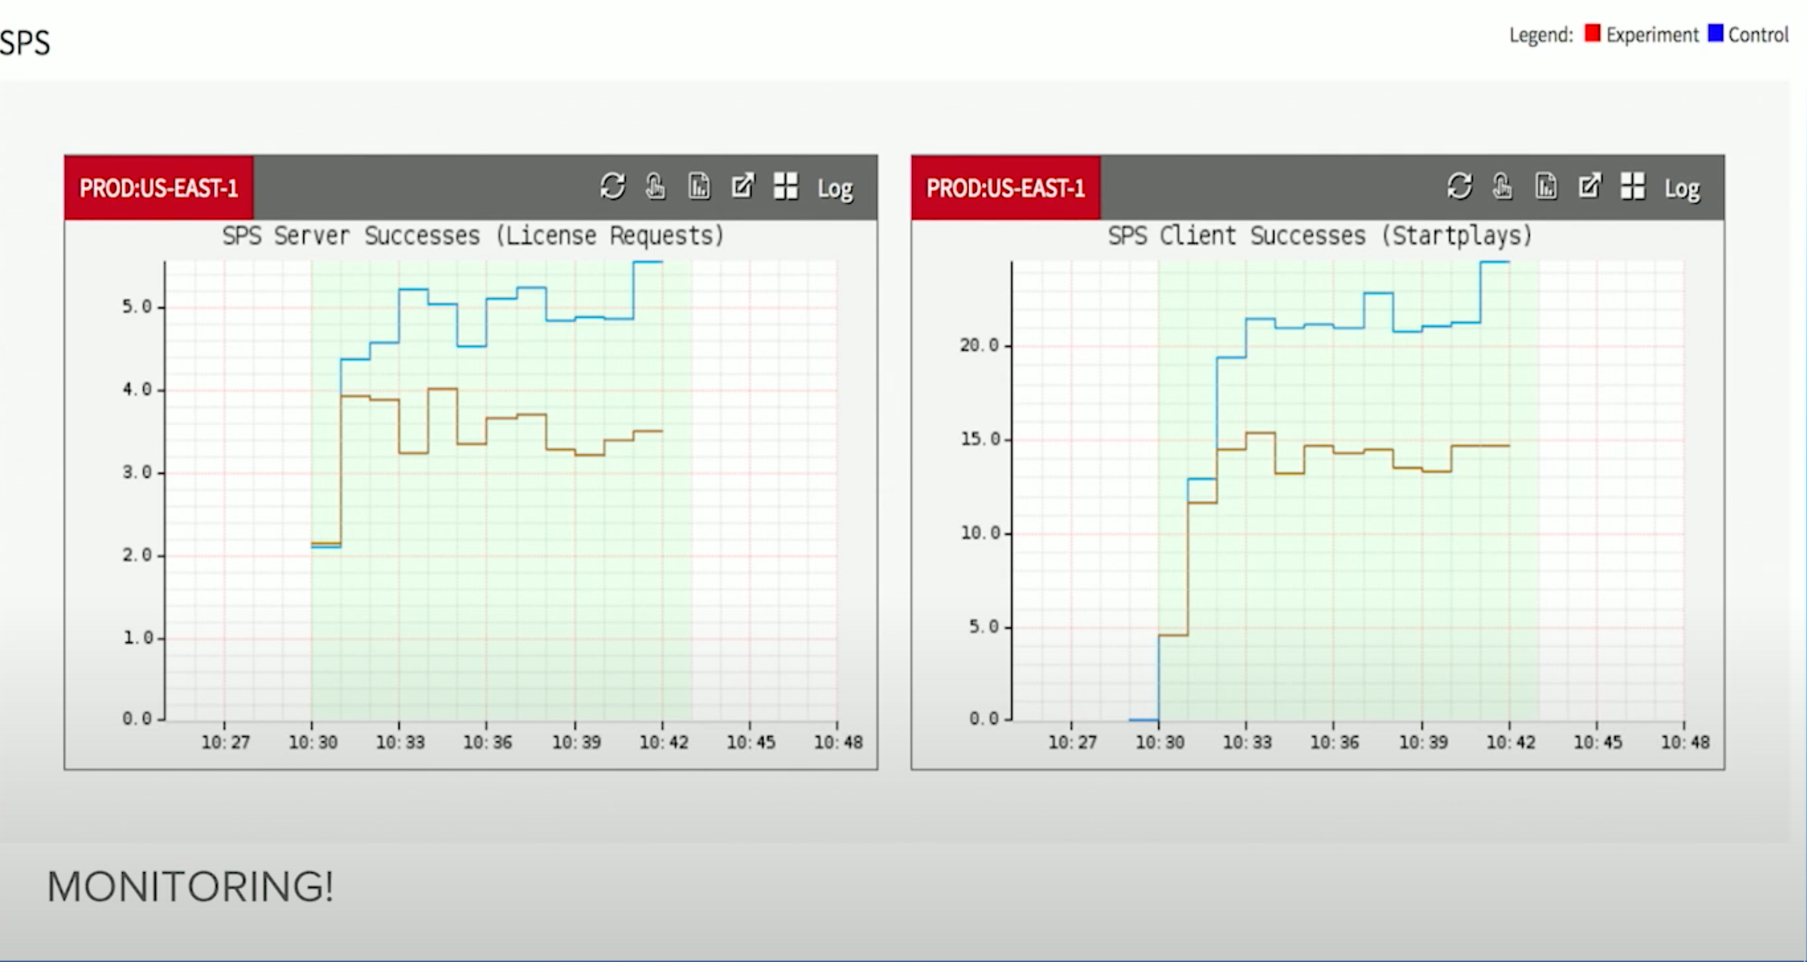
Monitoring
Automatically detecting irregular behavior at Netflix
https://www.youtube.com/watch?v=qyzymLlj9ag
Notes:
SPS - Netflix key business metric: “Stream starts per second” - can a user actually watch what they want to watch. If SPS deviates between control and expected, auto-rollback within seconds

Slide 20
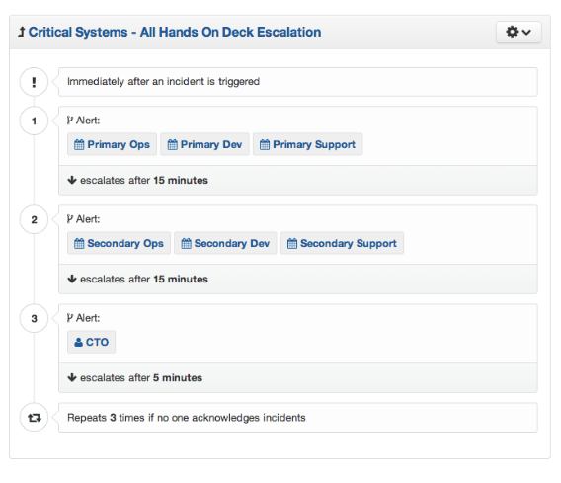
When things go wrong
Automated monitoring systems can notify “on-call” staff of a problem
Triage & escalation

Slide 21
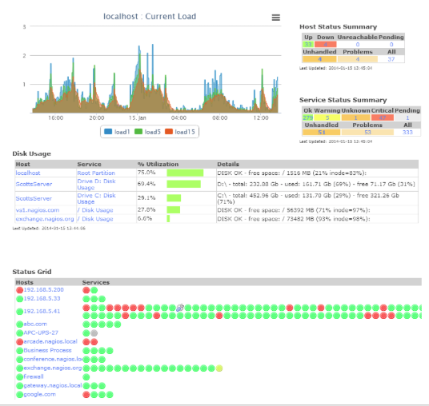
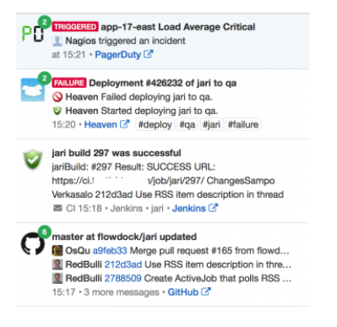
Monitoring Dashboards

Slide 22
This work is licensed under a Creative Commons Attribution-ShareAlike license
This work is licensed under the Creative Commons Attribution-ShareAlike 4.0 International License. To view a copy of this license, visit http://creativecommons.org/licenses/by-sa/4.0/
You are free to:
Share — copy and redistribute the material in any medium or format
Adapt — remix, transform, and build upon the material
for any purpose, even commercially.
Under the following terms:
Attribution — You must give appropriate credit, provide a link to the license, and indicate if changes were made. You may do so in any reasonable manner, but not in any way that suggests the licensor endorses you or your use.
ShareAlike — If you remix, transform, or build upon the material, you must distribute your contributions under the same license as the original.
No additional restrictions — You may not apply legal terms or technological measures that legally restrict others from doing anything the license permits.

